Slide 1
Enzymatic Processes in Industrial Production & its Application
Name : Raj Sheth.
Sec : Comps
D-25

Slide 2
Lipase
Lipase enzyme is a naturally occurring enzyme found in the stomach and pancreatic juice that digests fats and lipids, helping to maintain correct gallbladder function. These are present in animals, plants and as well as from several microorganisms and are sufficiently stable. These are considered as nature's catalysts, but commercially, only microbial lipases are being used significantly. In most of the living organisms, lipase enzymes are essential for digestion and transportation of lipids. In most living organisms, the lipase enzyme plays a crucial role in the digestion and transportation of lipids (fats and oils). Since lipase breaks down fat into smaller pieces, it is quite possible that lipase supplements might help in digestion. That’s the reason why many people use lipase as a medicine.

Slide 3
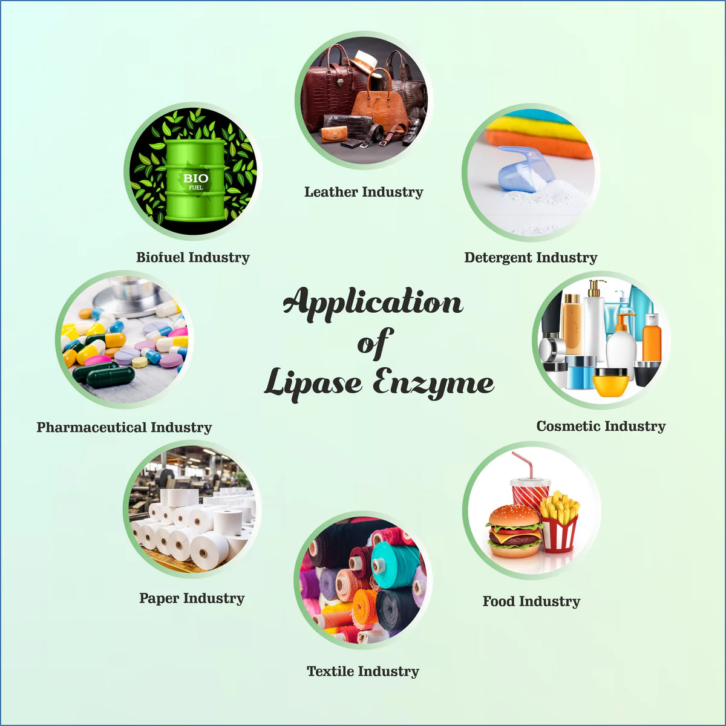
INDUSTRY APPLICATIONS
Lipase in the food industry
Commercial lipases are used in the food industry for adding flavour to dairy products and processing other food containing fats. They can also enhance the characteristic flavour of cheese by acting on the milk fats to produce free fatty acids after hydrolysis.
Lipase in the cosmetic industry
Presently, lipase is known to be an essential enzyme for biotechnological applications. In the cosmetic industry, this enzyme functions as an active ingredient in the cosmetic formulation and biocatalysts in synthesising specific cosmetic chemicals.

Slide 4
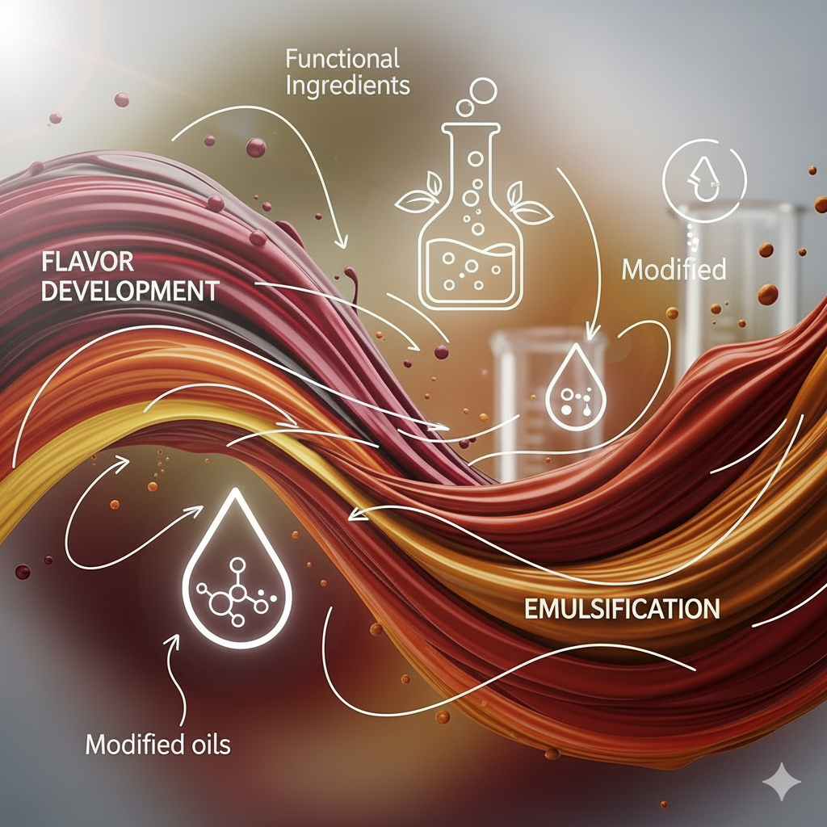
How Lipase Contributes to production in Food Industry
Flavor Development: In the dairy and baking sectors, lipases enhance or create aromatic notes in products like cheese, butter, and bread.
Emulsification: They improve the emulsifying properties of egg yolk lipids, leading to better texture and stability.
Functional Ingredients: Lipases help in creating new functional ingredients like cocoa butter or human milk fat equivalents by modifying fats and oils.
Modified Oils: They can modify vegetable oils to create fats with properties similar to human milk fat, suitable for infant formulas.

Slide 5
Role as an Engineering student
As a computer engineering student , I can help the food industry by not directly working with lipase in the lab, but by designing software, simulations, automation, AI models, and IoT systems that make lipase applications cheaper, faster, and more reliable.

Slide 6
References
https://pubmed.ncbi.nlm.nih.gov/30370868/
https://byjus.com/neet/lipase-enzyme/#:~:text=%E2%80%9CLipase%20is%20an%2\0enzyme%20that,functions%20of%20the%20different%20lipases.
https://infinitabiotech.com/blog/lipase-enzyme/

Slide 7
Thank You

